Slide 1
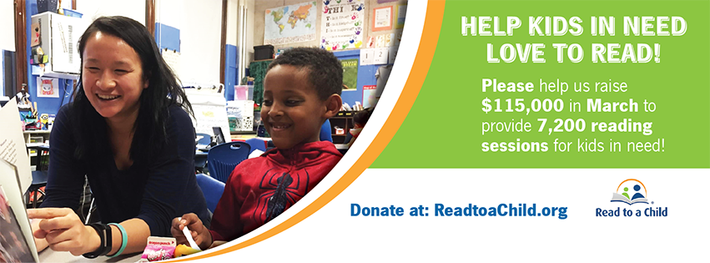
Help Kids in Need Love to Read
Read to a Child
2019 Online Campaign
Toolkit

Slide 2
Welcome!
And THANK YOU for joining Read to a Child’s sixth annual fundraising campaign -Help Kids in Need Love to Read!
We are thrilled to have you join the effort in helping to raise $115,000 in just one month that will go to provide 7,200 reading sessions for children in the upcoming school year! Our campaign will run for one month (March 2019) and will be ‘live’ on our Facebook page and other social media, with daily communications and engagement (including prizes) around developments and progress throughout the campaign.
This toolkit contains:
Campaign Details
How to Join
Fundraising Page Appeal & Example
Email Appeal & Example
Social Media Appeal & Example
Text Message Appeal & Example
Fun Fundraising Ideas
Poster
Poster Template for tailoring
Helpful Links
Thank you again for joining the campaign! If you should have any questions or need assistance on campaign materials etc. please contact me directly.
Best regards,
Kelsey Landeck
Development & Communications Coordinator
Kelsey.landeck@readtoachild.org
(781) 489-5910

Slide 3
Please join Read to a Child in raising $115,000 to help kids in need love to read during National Reading Month!
When: 1 March – 31 March, 2019
Goal: $115,000 in one month!
Astoundingly, 80% of 4th graders from low-income families are not proficient in reading and 2/3rds of those will end up on welfare or in jail!
Help Kids in Need Love to Read!
Read to a Child inspires caring adults to read aloud to children and to help create better opportunities for the future. Read to a Child’s volunteer reading mentors give their student partners the time, confidence and tools to reverse the cycle of illiteracy.
Join our campaign! March is ‘National Reading Month’ and Read to a Child is raising $115,000 in March, 2019 that will go to provide 7,200 reading sessions to children in need during the upcoming school year!
$25 can get a series of chapter books into a child's hands
$50 can provide screening and training of a volunteer
$100 can sponsor a year-end celebration and certificates for the children in the program
$250 can provide a school with new books customized to children's interests and teacher requests
and.... $500 can sponsor a child in Read to a Child's lunchtime reading program for a whole year!
The best way to stay up to date is to follow our social media platforms! We will be sharing leaderboards, donor matching opportunities, and different ways you can be entered to win prizes! Make sure you follow our social medias here:
@readtoachild.org
@ReadtoaChild
@ReadtoaChild
/company/read-to-a-child/
Visit our campaign page at: https://readtoachild.networkforgood.com/projects/51446-read-to-a-child-help-kids-in-need-love-to-read

Slide 4
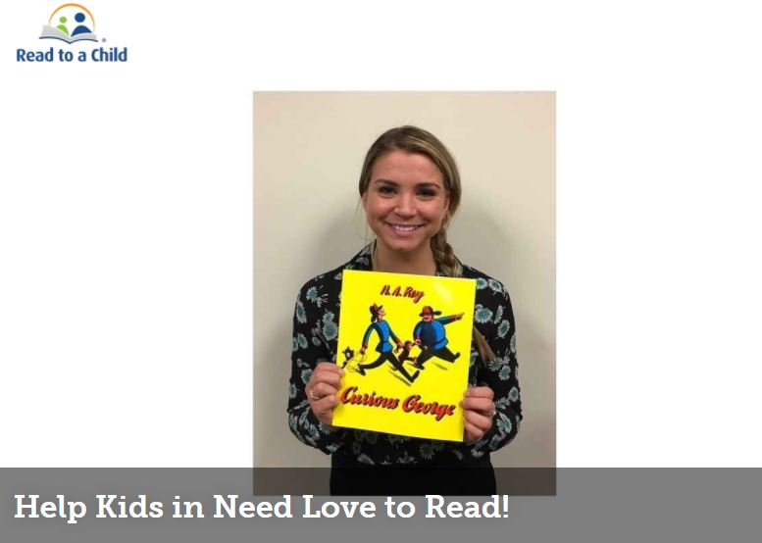
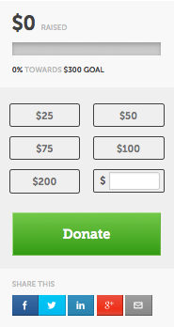
How to Join
Sign Up at:
1
Sign up at Network for Good: https://readtoachild.networkforgood.com/projects/51446-read-to-a-child-help-kids-in-need-love-to-read
2
Simply share your own short personal story about your love of reading along with the Read to a Child appeal & upload a fun ‘selfie’.
3
You can send the appeal from your fundraising page using the ‘share this’ menu icons for Facebook, Twitter, LinkedIn, Google+ or send it out via email or text message.
For more detailed instructions: https://tinyurl.com/createapageinstructions
For video instructions: https://tinyurl.com/createapagevideo
For more information or questions on the campaign, please contact: Kelsey Landeck at (781) 489-5910 or kelsey.landeck@readtoachild.org

Slide 5
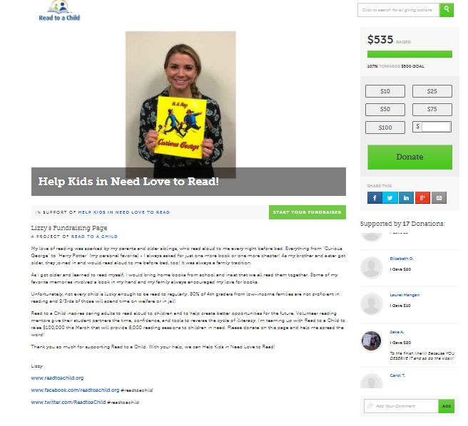
Fundraising Page Appeal & Example
(Insert your short personal story)
My love of reading was sparked by my parents and older siblings, who read aloud to me every night before bed. Everything from "Curious George" to "Harry Potter" (my personal favorite) - I always asked for just one more book or one more chapter! As my brother and sister got older, they joined in and would read aloud to me before bed, too! It was always a family tradition.
As I got older and learned to read myself, I would bring home books from school and insist that we all read them together. Some of my favorite memories involved a book in my hand and my family always encouraged my love for books.
Unfortunately, not every child is lucky enough to be read to regularly. 80% of 4th graders from low-income families are not proficient in reading and 2/3rds of those will spend time on welfare or in jail!
Read to a Child inspires caring adults to read aloud to children and to help create better opportunities for the future. Volunteer reading mentors give their student partners the time, confidence, and tools to reverse the cycle of illiteracy. I'm teaming up with Read to a Child to raise $115,000 this March that will provide 7,200 reading sessions to children in need. Please donate on this page and help me spread the word!
Thank you so much for supporting Read to a Child. With your help, we can Help Kids in Need Love to Read!
www.readtoachild.org
www.facebook.com/readtoachild.org #readtoachild
www.twitter.com/ReadtoaChild #readtoachild

Slide 6
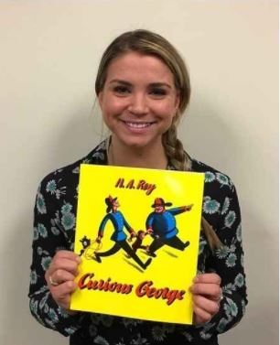
Email Appeal & Example
To: My circle of friends, family & colleagues
Subject: Help Kids in Need Love to Read!
Dear Friend,
My love of reading was sparked by my parents, who read me a bedtime story each night. This nightly ritual always left me clamoring for more and looking forward to the next evening’s adventure. Unfortunately, not everyone is lucky enough to be read to regularly. Astoundingly, 80% of 4th graders from low-income families in the U.S. are not proficient in reading and 2/3rds of those will end up on welfare or in jail!
(Insert your fun selfie here)
Help Kids in Need Love to Read!
Read to a Child enables caring adults to read aloud to children and to help create better opportunities for the future. Read to a Child’s volunteer reading mentors give their student partners the time, confidence and tools to reverse the cycle of illiteracy.
Please Sponsor Me! Make a Donation to Read to a Child
March is ‘National Reading Month’ and I’m helping Read to a Child raise $115,000 by March 31st that will go to provide 7,200 additional reading sessions to children in need during the 2019-20 school year! Help me reach my personal fundraising goal of (insert your fundraising goal here)! You can show your support by making a donation at my (insert your fundraising page link here).
$25 can get a series of chapter books into a child's hands
$50 can provide screening and training of a volunteer
$100 can sponsor a year-end celebration and certificates for the children in the program
$250 can provide a school with new books customized to children's interests and teacher requests
and.... $500 can sponsor a child in Read to a Child's lunchtime reading program for a whole year!
Join Us! Help Read to a Child Fundraise
You can join the campaign by signing up to fundraise at Network for Good
Thank you for your support,
Your name,
https://readtoachild.networkforgood.com/projects/12107-read-to-a-child-help-kids-in-need-love-to-read

Slide 7
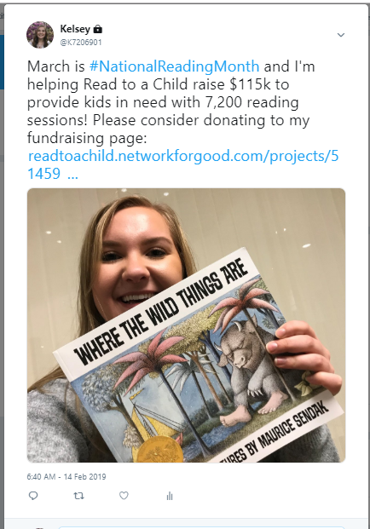
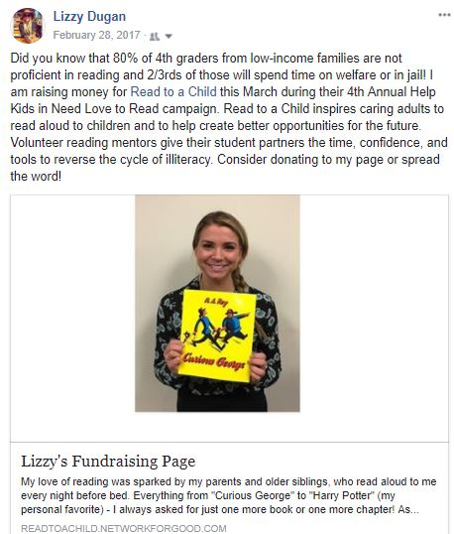
Social Media Appeal & Example
Share your fundraising page across all your social media platforms like Facebook, Twitter, Instagram, and LinkedIn! Be sure to tag us in your efforts!
(Insert your own short personal story or use wording from the main donation page)
Did you know that 80% of 4th graders from low-income families are not proficient in reading and 2/3rds of those will spend time on welfare or in jail! I am raising money for Read to a Child this March during their 6th Annual Help Kids in Need Love to Read campaign. Read to a Child inspires caring adults to read aloud to children and to help create better opportunities for the future. Volunteer reading mentors give their student partners the time, confidence, and tools to reverse the cycle of illiteracy. Consider donating to my page or spread the word!
(insert your fundraising link)

Slide 8
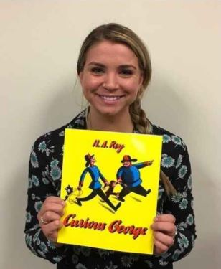
Text Message Appeal & Example
Hello Friend,
March is National Reading Month and I’m helping Read to a Child raise $115k to provide kids in need with 7,200 reading sessions! Together we can spark something meaningful. Anything you can do to help will be greatly appreciated. My donation page (insert link to donation page and image)
Hello Brian,
March is National Reading Month and I’m helping Read to a Child raise $100k to provide kids in need with 6,000 reading sessions! Together we can spark something meaningful. Anything you can do to help will be greatly appreciated. My donation page goo.gl/7sXvCY
4:22pm MMS

Slide 9
Fun Fundraising Ideas
You can fundraise while getting your colleagues involved! Keep in mind, people love to ‘get something’ when they ‘give something’. Here are a few ideas:
Bake sales are always popular at the office and people love to bake! Ask colleagues to volunteer to ‘be a baker’ and bring in baked goods to sell for fundraising. Optionally, you could amp it up and include a bake-off competition with judging, prizes and bragging rights!
A chance to win something! Host a raffle and sell tickets to fundraise using prizes like a vacation day, or ask local businesses to donate prizes.
Host a special day at the office to show support, such as ‘Wear Jeans/Shorts to Work’ for a $5 donation to participate.
Host a an event at the office to gather colleagues while raising funds. Could be after work cocktails/beer, bagel breakfast, afternoon ice cream social etc. request a ‘suggested donation’ for participation.
At events, ask attendees to take photos and share on social media using the hashtag #readtoachild

Slide 10
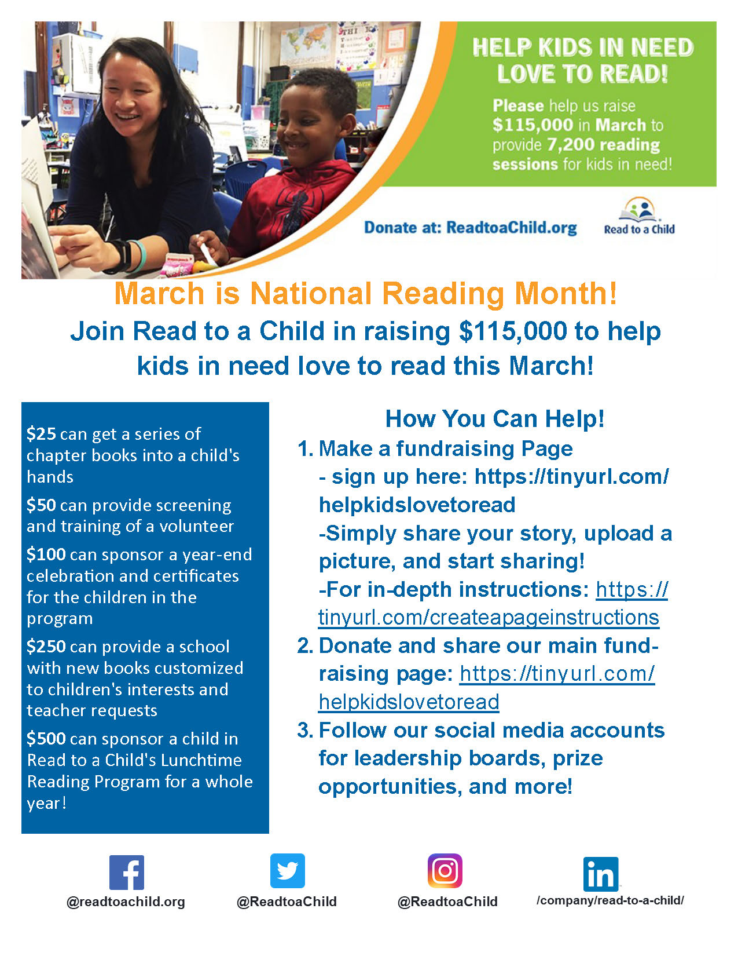

Slide 11
Use this blank template to create your own tailored communications, posters etc.

Slide 12
Helpful Links
Read to a Child’s Campaign page: https://readtoachild.networkforgood.com/projects/51446-read-to-a-child-help-kids-in-need-love-to-read
Sign up to fundraise at Network for Good: https://readtoachild.networkforgood.com/projects/51446-read-to-a-child-help-kids-in-need-love-to-read
Instructions for Creating a Fundraising Page: https://tinyurl.com/createapageinstructions
Making a Fundraising Page video: https://tinyurl.com/createapagevideo
Read to a Child Facebook page: https://facebook.com/readtoachild.org
Read to a Child Twitter page: https://twitter.com/ReadtoaChild
Read to a Child Instagram page: https://instagram.com/readtoachild/
Read to a Child LinkedIn page: https://www.linkedin.com/company/read-to-a-child
For more information please contact Kelsey Landeck at: kelsey.landeck@readtoachild.org or (781) 489-5910

